Slide 1


Slide 2

Agenda: Power BI
Introduction to Power BI and Key Features
Exploring Power BI Desktop Interface
Data Transformation and Modeling
Data Analysis Expressions (DAX)
Advanced DAX Calculations
Charts, Page Layouts, and Dashboard Creation
Publishing, Sharing, and Hands-On Exercises

Slide 3
Introduction to Power BI
Power BI is a powerful business intelligence and data visualization tool developed by Microsoft.
Data Connectivity: Connect to various data sources.
Data Transformation: Clean, reshape, and combine data using Power Query.
Data Modeling: Create relationships, calculated columns, and measures.
Report Authoring: Build interactive reports and dashboards in Power BI Desktop.
DAX: Use Data Analysis Expressions for custom calculations.
Data Insights: Quick Insights feature for automatic pattern discovery.
Sharing: Publish, share, and collaborate on reports in Power BI Service.
Mobile Access: Access and interact with reports on mobile devices.
Custom Visualizations: Extend and customize visuals.
Security and Governance: Ensure data privacy and compliance.

Slide 4
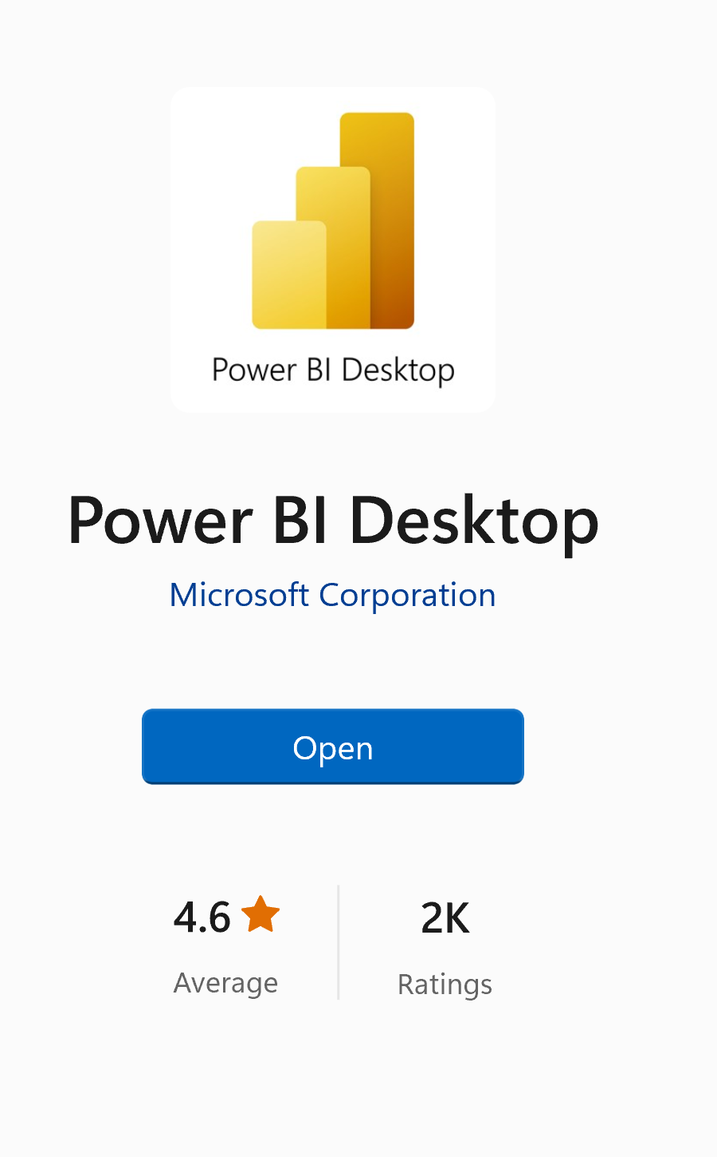
Introduction to Power BI
Installation and Setup:
Download Power BI Desktop from the Microsoft website.
Install Power BI Desktop on your Windows computer.
Create a Power BI Service Account for sharing and collaboration.
Connect to Data from your data sources.
Build Your Reports using Power BI Desktop.
Publish to Power BI Service for sharing and setting data refresh schedules.

Slide 5
Introduction to Power BI
Power BI and Power BI Desktop
Feature | Power BI | Power BI Desktop
Role | Entire ecosystem for BI | Standalone report authoring
Platform | Cloud-based, web, and mobile | Windows application
Collaboration | Share, collaborate, and publish | Report creation and design
Access | Accessible via web and mobile | Can be used offline
Cost | Typically, subscription-based | Free to download and use

Slide 6
Power BI Desktop Interface
Overview of Power BI Desktop Interface:
Ribbon: Top menu for actions and tasks.
Visualizations Pane: Right-side panel for configuring visuals.
Fields Pane: Right-side panel displaying data fields.
Report View: Central canvas for building visuals.
Pages Pane: Left-side panel for managing report pages.
Filters Pane: Right-side panel for adding filters.
Data View: View the underlying data tables.
Model View: Visualize table relationships.

Slide 7
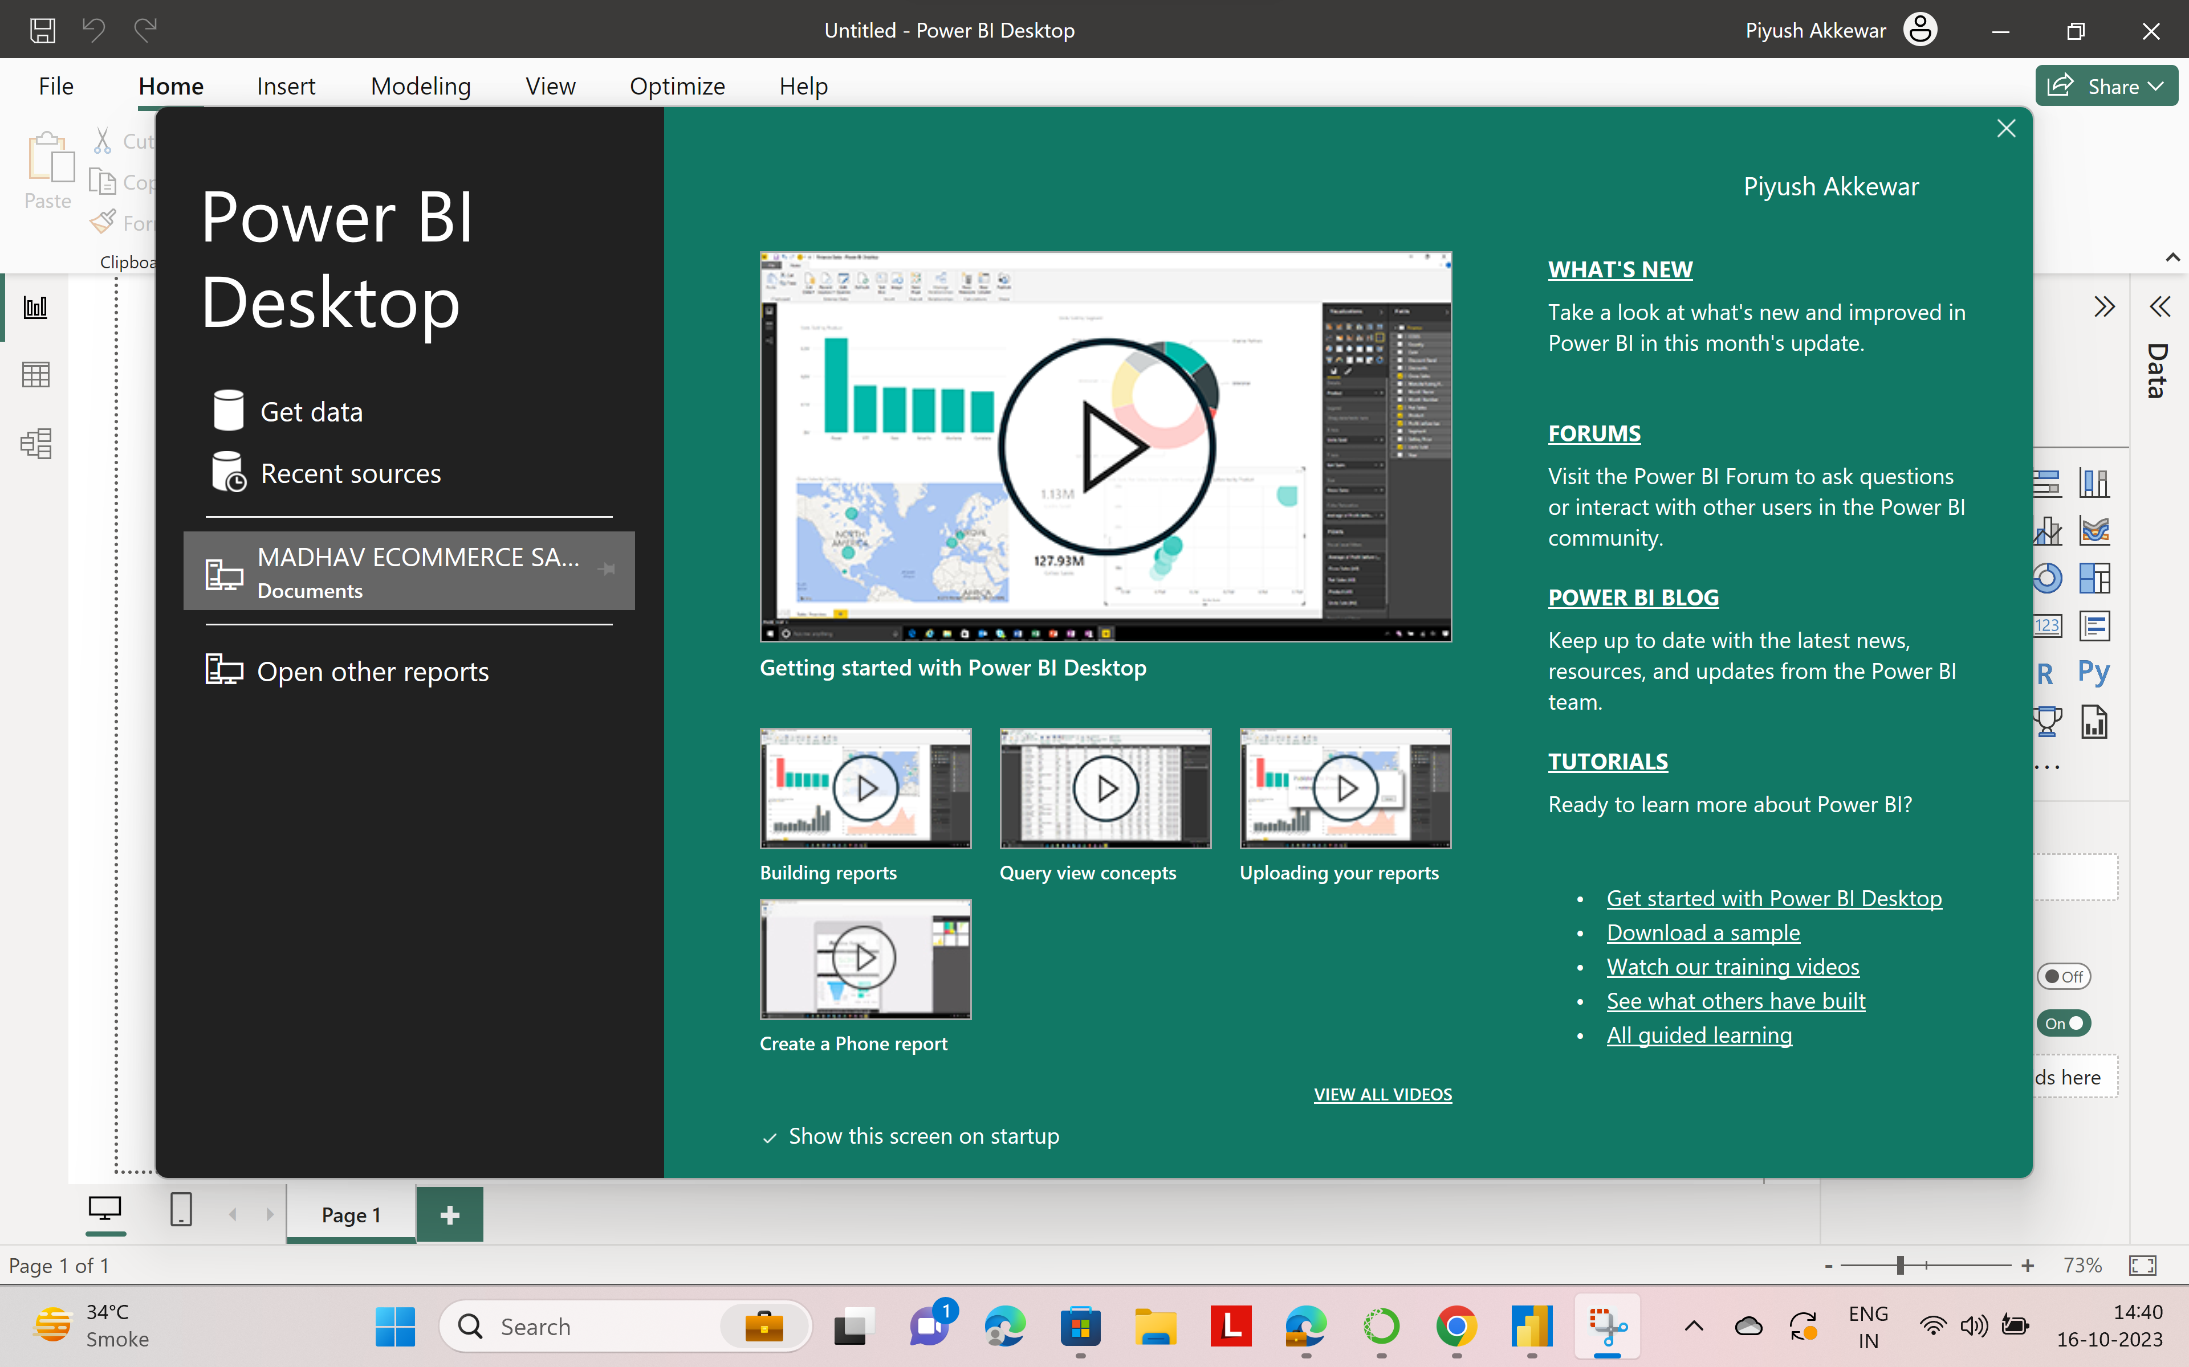
Power BI Desktop Interface

Slide 8
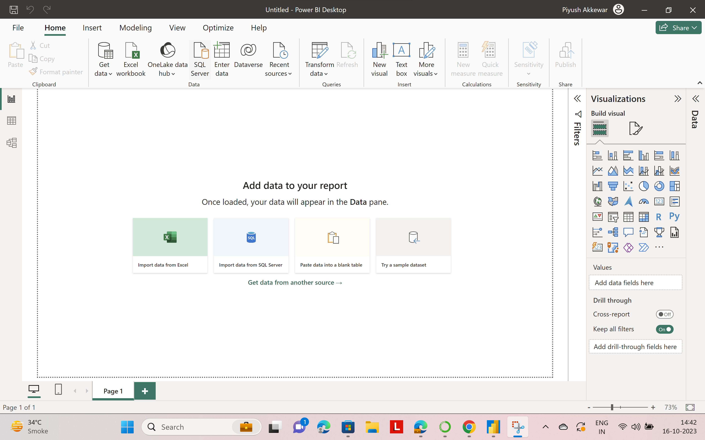
Power BI Desktop Interface

Slide 9
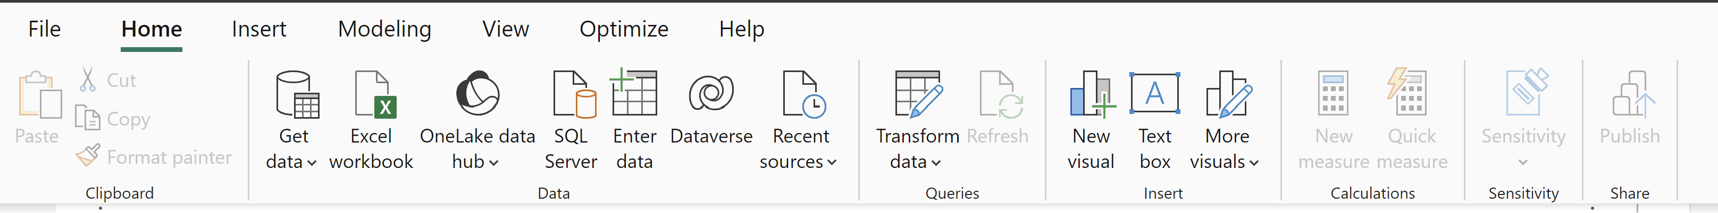
Power BI Workspace Elements
Ribbons:
Home, Model, View, Transform Data, External Data: Manage data, visuals, and design settings.

Slide 10
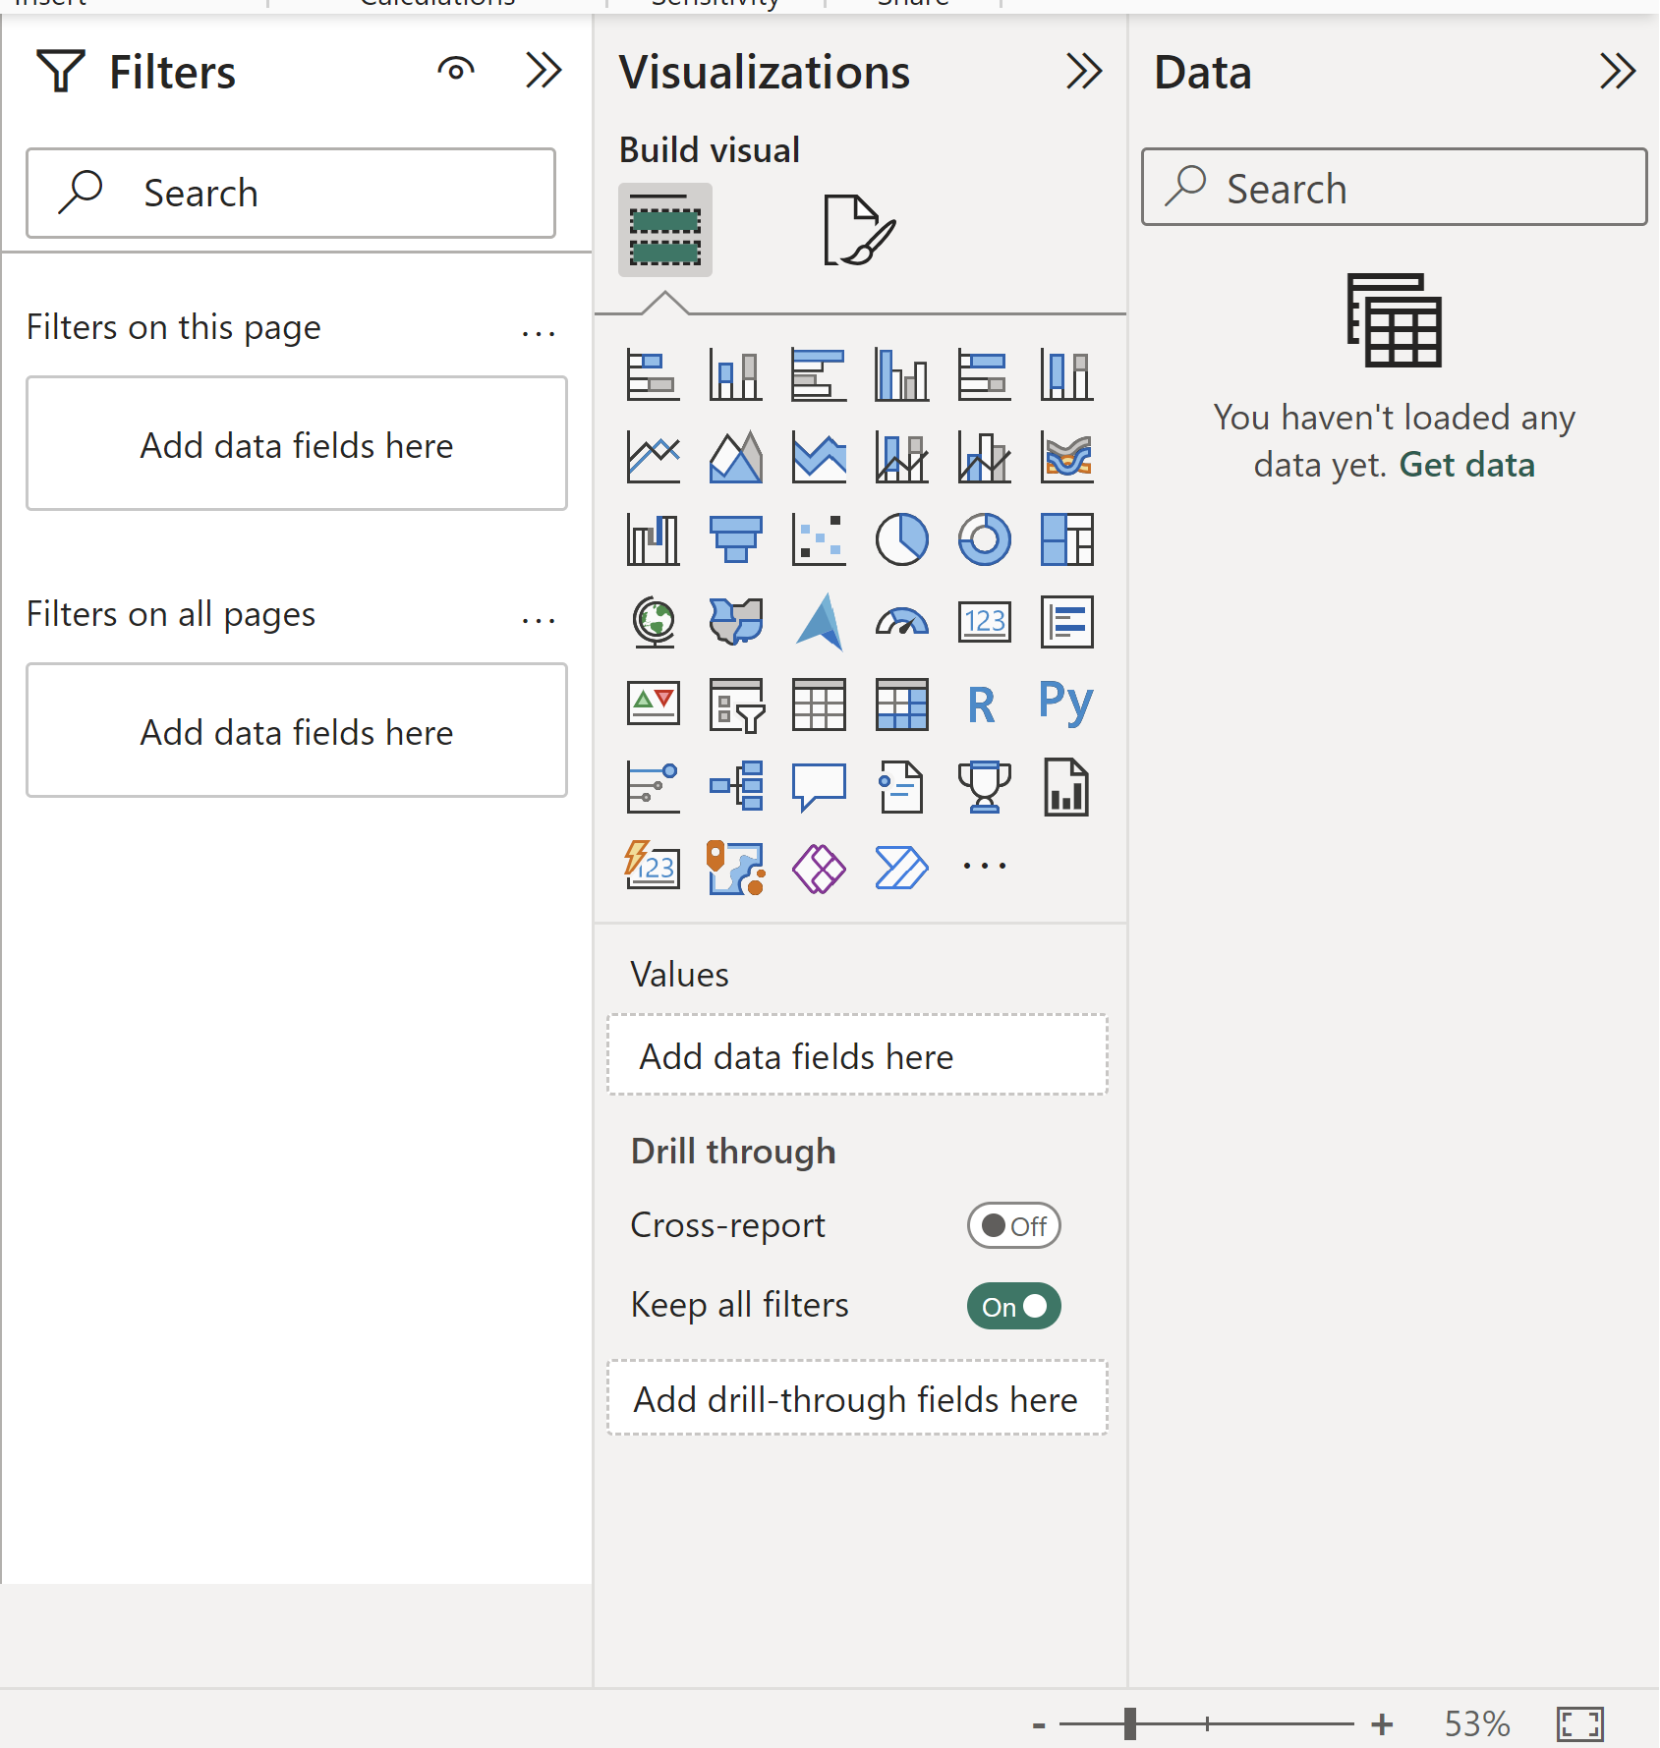
Power BI Workspace Elements
Panes:
Fields Pane: Connect to data sources and select fields.
Visualizations Pane: Choose visual types and customize them.
Filters, Selection Pane: Add interactivity and manage visual layers.

Slide 11
Power BI Workspace Elements
Menus:
File, Edit, View, Data, Model, Visualizations: Access file operations, editing, view settings, data management, and report customization.

Slide 12
Data Transformation
Import Data: Load your data into Power BI from various sources.
Query Editor: Access it from the Home tab for data transformation.
Filter Data: Remove unnecessary rows/columns.
Transform Data: Change data types, split/merge columns, create custom columns.
Clean Data: Handle missing values and data anomalies.
Data Modeling: Create relationships between tables if needed.
DAX Calculations: Use Data Analysis Expressions to create custom calculations and measures.
Loading Data: Apply data transformations and load data for visualization.
Data Refresh: Set up automatic data refresh for dynamic data sources.

Slide 13
Data Modeling
Data Modeling Concepts:
Tables: Identify data tables.
Columns: Understand attributes.
Relationships: Define connections.
Establishing Relationships:
Identify Keys: Use unique identifiers.
Create Relationships: Connect related data.
Hierarchies:
Date Hierarchies: Year > Quarter > Month > Day.
Custom Hierarchies: Define custom data structures.

Slide 14
Data Analysis Expressions (DAX)
DAX is a formula language in Power BI for creating custom calculations.
It includes functions and operators for data manipulation.
Functions and Calculations:
DAX Functions: Predefined functions like SUM and AVERAGE.
Aggregations: DAX allows you to perform calculations like totals and averages.
Step-by-Step DAX Expressions:
Create DAX expressions by combining functions, operators, and data values.
Commonly used for creating measures to calculate specific metrics.

Slide 15
Data Analysis Expressions (DAX)
You have a sales dataset with columns for "Sales Amount" and "Quantity Sold." You want to create a new measure that calculates the average sales per item sold.
DAX Expression:
Average Sales per Item = SUM('Sales'[Sales Amount]) / SUM('Sales'[Quantity Sold])
In this DAX expression:
SUM('Sales'[Sales Amount]) calculates the total sales amount.
SUM('Sales'[Quantity Sold]) calculates the total quantity sold.
The division / is used to find the average sales per item sold.

Slide 16
Data Analysis Expressions (DAX)
You have a sales dataset with columns for "Sales Amount" and "Quantity Sold." You want to create a new measure that calculates the average sales per item sold.
DAX Expression:
Average Sales per Item = SUM('Sales'[Sales Amount]) / SUM('Sales'[Quantity Sold])
In this DAX expression:
SUM('Sales'[Sales Amount]) calculates the total sales amount.
SUM('Sales'[Quantity Sold]) calculates the total quantity sold.
The division / is used to find the average sales per item sold.

Slide 17
Data Analysis Expressions (DAX)
Advanced DAX Calculations:
Time Intelligence: DAX functions for analyzing data over time, like year-to-date or moving averages.
Filters and Slicers: Creating dynamic measures based on user-selected filters.
Measures and Calculations: Advanced DAX for complex insights like customer retention or cohort analysis.
Real-World Examples: Analyzing sales seasonality, custom date range filters, and tracking customer behavior.
Use Cases: Financial forecasting, interactive dashboards, and optimizing marketing campaigns using advanced DAX in Power BI.

Slide 18
Charts and Page Layouts
Creating Effective Charts:
Choose the right chart type for your data.
Simplify data to focus on key information.
Use colors judiciously for clarity.
Provide clear labels and legends.
Make charts interactive for exploration.
Page Layout Design Tips:​
Maintain a consistent design theme.​
Use white space to reduce clutter.​
Add clear navigation elements.​
Ensure mobile-friendliness.​
Test with users for feedback and improvements.​

Slide 19
Creating a Power BI Dashboard
Data Import: Import your data source into Power BI Desktop.
Data Transformation: Clean, shape, and transform the data as needed using Power Query Editor.
Data Modeling: Define relationships, keys, and hierarchies in the Data Model view.
Data Visualization: Drag and drop visual elements (charts, tables, etc.) onto the report canvas.
Page Layout: Organize visuals on report pages with a clear structure.
Filters and Slicers: Add filters and slicers for interactivity and data exploration.

Slide 20
Creating a Power BI Dashboard
Calculated Columns and Measures: Create DAX calculations for custom data analysis.
Testing: Review and test the dashboard for accuracy and functionality.
Publish: Publish the report to the Power BI Service.
Share and Collaborate: Share the dashboard with others, set up dashboards in workspaces, and collaborate.
Refresh Data: Schedule data refresh to keep the dashboard up-to-date.
Monitor and Iterate: Monitor usage, gather feedback, and make improvements as needed.

Slide 21
Publishing and Sharing
Publish Report: Upload your Power BI report to the Power BI Service.
Workspace Access: Choose a workspace for your report in the Power BI Service.
Security and Permissions: Control who can access the report by defining roles and access levels.
Share with Others: Share the report with specific people via email invitations.
Collaboration Features: Utilize comments, annotations, and discussion threads for collaboration.
Embed Reports: Embed reports in websites or apps and configure security settings.
Scheduled Refresh: Set up data refresh schedules to keep the report current.
Mobile Access: Access the report on mobile devices using the Power BI mobile app.
Feedback and Iteration: Gather user feedback and make improvements, as necessary.

Slide 22
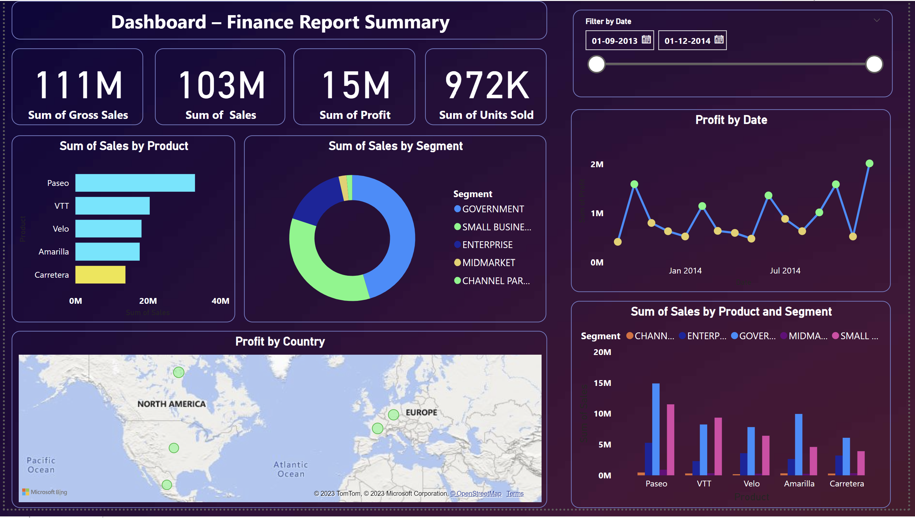
Hands-on: Create a Dashboard
Dataset: Dashboard – Financial Report Summary
Notes:
Note:- Use Power BI file for this Exercise

Slide 23
Questions ?

Slide 24
Thank You !

